Slide 1
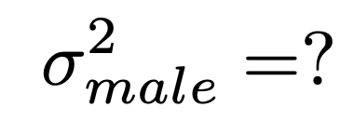



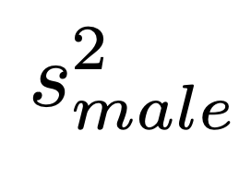
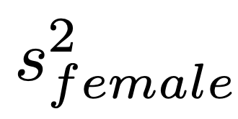
Assume:
Estimates population variance
Estimates population variance

Slide 2

Estimates population variance
Estimates population variance

Slide 3
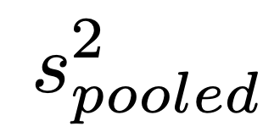
Estimates population variance

